Slide 1
Implementing Code of Conduct on Safety and Security of Radioactive Sources in Malaysia
CN-177/27
International Conference on Effective Nuclear Regulatory Systems: Further Enhancing the Global Nuclear Safety and Security Regime 14–18 December 2009 Cape Town, South Africa
Marina Mishar & Najwa Hassan
Atomic Energy Licensing Board
Ministry of Science, Technology & Innovation (MOSTI)
Batu 24, Jalan Dengkil, 43800, Dengkil, Selangor
Ensuring Safety, Security & Safeguarding Peaceful Nuclear Activities

Slide 2
CONTENTS
Malaysian Legal Infrastructure
Adoption of the CoC on Safety & Security of RAS
Security Provisions
Security Enhancement of Radioactive Sources
Awareness and Training
Future Plans
Conclusions

Slide 3
Malaysian Legal Infrastructure
CONTROL OF
Radioactive Material
Nuclear Material
Irradiating Apparatus
Prescribed Substance
Regulatory Body
Atomic Energy Licensing Board &
Department of AELB
Licensing Authority for Medical Purposes
Director General of Health
Atomic Energy
Licensing Act 1984
(Act 304)

Slide 4
Adoption of CoC on the Safety & Security of Radioactive Sources
18.5.07
AEL Board Adopted the CoC
Depart of AELB tabled Strategy & Action Plan Paper
Review of Current Legal Provisions
Implemen -tations

Slide 5
Adoption of the CoC: What does it means?
Regulatory Measures—inspection frequency, notifications, licensing, registration, allocation of resources
Security Measures—Ensure measures are appropriate
National registry of sources—Optimize decisions regarding which sources should be included
Import/Export Controls—More stringent control on Category 1 & 2 Radioactive Sources
Labeling of high-activity sources—in addition to the trefoil
Emergency preparedness and response—appropriate to the category
Prioritization for regaining control of orphan sources
Communication with the public—relative hazards

Slide 6
Adoption of the CoC: Security Enhancement Strategy
Strategy 1
Enhancing Self-Compliance towards Safety & Security Culture
Strategy 2
Strengthening Technical Capabilities & Competency of Enforcement Agencies
Strategy 3
Knowledge Empowerment for Public
Strategy 4 Enhancing Incident Response Capability
Notes:
Knowledge Empowerment for Public
Meningkatkan kesedaran di kalangan orang awam berhubung bahan radioaktif, lambang sinaran, langkah-langkah keselamatan dan tindakan yang perlu diambil apabila berhadapan dengan situasi terjumpa punca radioaktif tidak bertuan.
Enhancing Self-Compliance towards Safety & Security Culture
Meningkatkan kesedaran dan pengawalan/sekuriti bahan radioaktif di kalangan pemegang lesen sebagai benteng pertama menghapuskan kejadian punca radioaktif tidak bertuan.
Strengthening Technical Capabilities and Competency of Enforcement Agencies
Meningkatkan keupayaan teknikal agensi-agensi penguatkuasa di sempadan antarabangsa bagi memastikan tidak berlaku kejadian keluar/masuk bahan radioaktif yang tidak bertuan.
Enhancing Incident Response Capability
Meningkatkan keupayaan teknikal ahli Pasukan Bertindak Kecemasan AELB supaya dapat memberi respon yang cepat dan berkesan bagi mengawal semula situasi apabila berlaku kecemasan/kejadian radiologi terutamanya apabila aduan kejadian bahan radioaktif tidak bertuan dan kejadian ancaman ”malicious”.

Slide 7
Security Provision
Act
304
Regulations
License Conditions
Short Title
To provide for the regulation and control of atomic energy ;
For matters connected therewith or related thereto
Section 17, Act 304
License conditions
Notes:
License Conditions – Section 17, Act 304
17. (1) Licences issued under this Act shall be subject to such conditions as may, be imposed by the appropriate authority which may in respect of the conditions imposed by it, add to, vary or revoke such conditions at any time.

Slide 8
Security Provision
Act
304
Regulations
License Conditions
Reg. 21(f) and 25, Licensing Regulation
Reg. 52, Radiation Protection (BSS) Regulations
Notes:
Licensing Regulations
21. An application for the temporary operation stage of a licence to operate a nuclear installation shall contain all the information required under regulations 19 and 20, and shall also contain the following informations:
(f) the proposed plan and procedures to prevent loss, theft or unauthorized use of radioactive materials, nuclear materials or prescribed substance.
25. The appropriate auhtority may, at any time during the construction and development of the facility, require, in writing, the applicant to furnish such information as it may consider reasonably necessary in order to evaluate the halth and safety of workers and members of the public, the security of the country and the environmental aspects of the development and future operation of the facility.
Regulation 52 : The licensee shall take measures to protect all radioactive materials, nuclear materials, prescribed substances, irradiating apparatus and facilities to prevent theft or sabotage

Slide 9
Security Enhancement : Legal Infrastructure
Effective 1 Jan 2009
Utilize current legal mandate to implement enhancement of security measures on users (Reg. 52, Radiation Protection (BSS) Regulations)
Include Security Requirements
License conditions
Radiation Protection Program
Training & Certification Syllabus of RPO (JKPPPS)
Inspection Procedures

Slide 10
Security Enhancement : Legal Infrastructure
Import/Export Procedures
New procedure drafted & e-implementation pending e-Permit system finalization with Customs Department
Manual implementation on going
Review & Strengthen Legislation
Review of Act 304 to include security provisions
New regulations on security & physical protection planned –started Q2 2009
Review related treaties & conventions and input used to strengthen the national legislation

Slide 11
Security Enhancement: Physical Infrastructure
Portal Monitors at selected international borders – under RMk9 : starts in Aug 2008
Emergency Response Center – special unit under Enforcement Division
Radioactive Sources Database – upgrading of current database- under RMk9

Slide 12
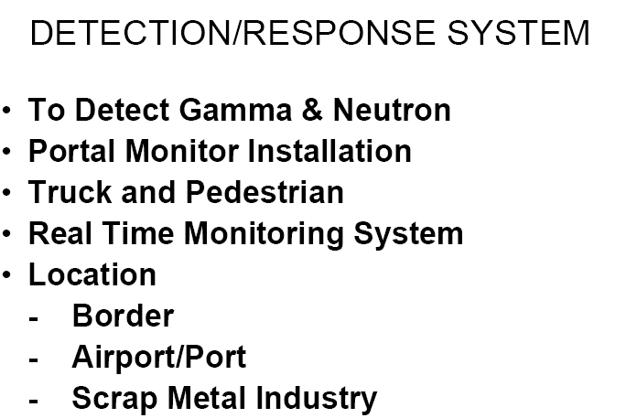
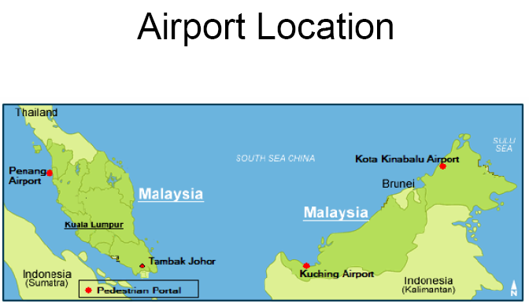
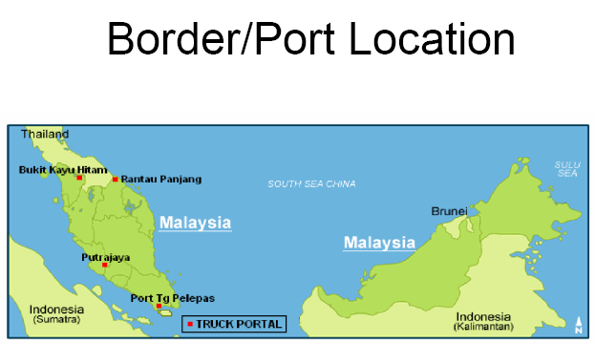
Security Enhancement: Physical Infrastructure
Enhancing our technical capabilities at Malaysian international borders – installing portal monitors

Slide 13
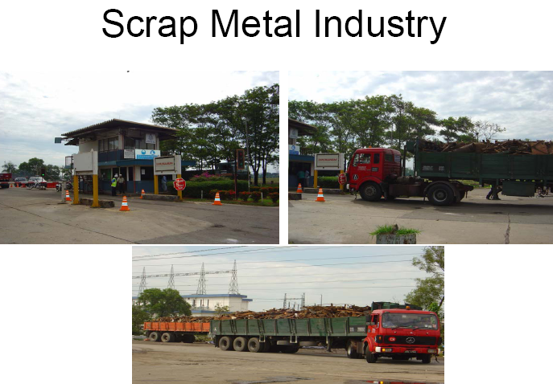
Security Enhancement: Physical Infrastructure

